Slide 1
Python: Features, Applications & Advanced Concepts

Slide 2

Slide
Title: Python: Features, Applications & Advanced Concepts

Slide 3

Python: An Overview
High-level, interpreted, general-purpose language.
Emphasizes code readability through indentation.
Supports multiple programming paradigms.
Extensive standard library.

Slide 4

Dynamic Typing in Python
Variables defined without explicit type declaration.
Faster prototyping and development.
Potential for runtime type errors.
Requires careful type management.

Slide 5

Programming Paradigms
Supports object-oriented programming.
Enables imperative programming style.
Facilitates functional programming.
Provides flexibility in code structure.

Slide 6

Standard Library
Modules for various tasks.
File I/O and network communication.
String manipulation and OS interaction.
Reduces reliance on external dependencies.

Slide 7

Automatic Memory Management
Garbage collection handles memory.
Reduces manual memory allocation burden.
Increases development speed.
Reduces risk of memory leaks.

Slide 8

Global Interpreter Lock (GIL)
CPython implementation restricts parallelism.
Only one thread holds interpreter control at a time.
Limits true parallelism for CPU-bound tasks.
Use multiprocessing for genuine concurrency.

Slide 9
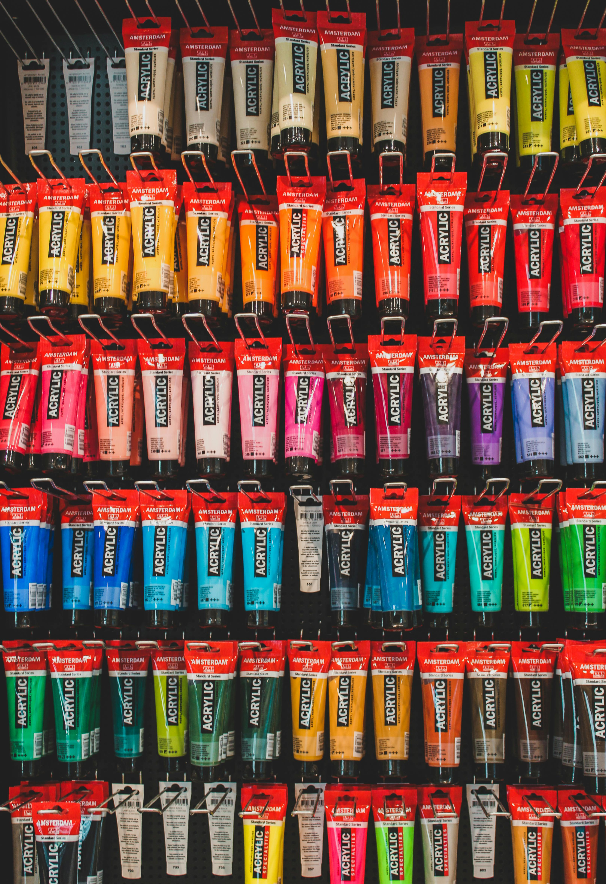
Decorators
Modify/extend function/method behavior.
Wrap functions with additional functionality.
Clean and reusable code modification.
Applied before/after function execution.

Slide 10

Code Example
def decorator_example(func):
def wrapper(*args, **kwargs):
print("Before function call")
result = func(*args, **kwargs)
print("After function call")
return result
return wrapper
@decorator_example
def say_hello(name):
return f"Hello, {name}!"
print(say_hello("World"))

Slide 11
Code Example
def decorator_example(func): def wrapper(*args, **kwargs): print("Before function call") result = func(*args, **kwargs) print("After function call") return result return wrapper @decorator_example def say_hello(name): return f"Hello, {name}!" print(say_hello("World"))

Slide 12
Code Example
def decorator_example(func): def wrapper(*args, **kwargs): print("Before function call") result = func(*args, **kwargs) print("After function call") return result return wrapper @decorator_example def say_hello(name): return f"Hello, {name}!" print(say_hello("World"))

Slide 13
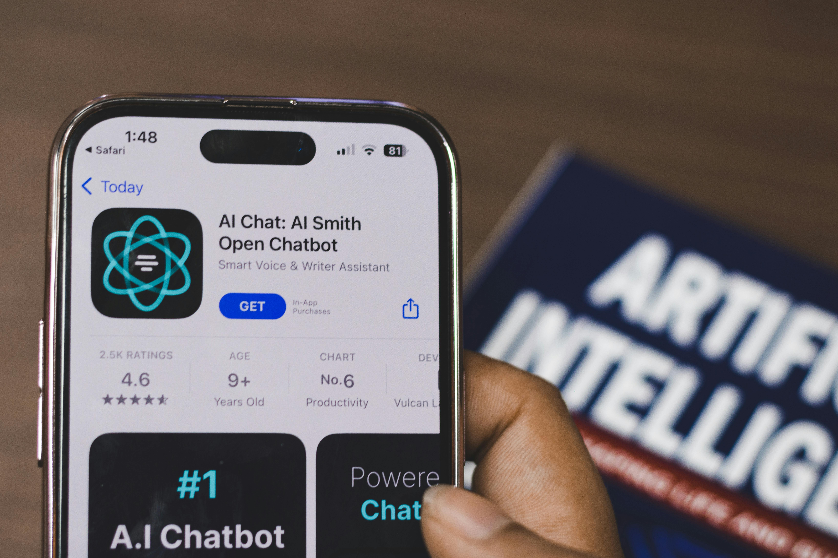
Metaclasses
Classes of classes.
Control class creation and behavior.
Enables automatic attribute registration.
Supports singleton implementation.
Useful for API validation.

Slide 14
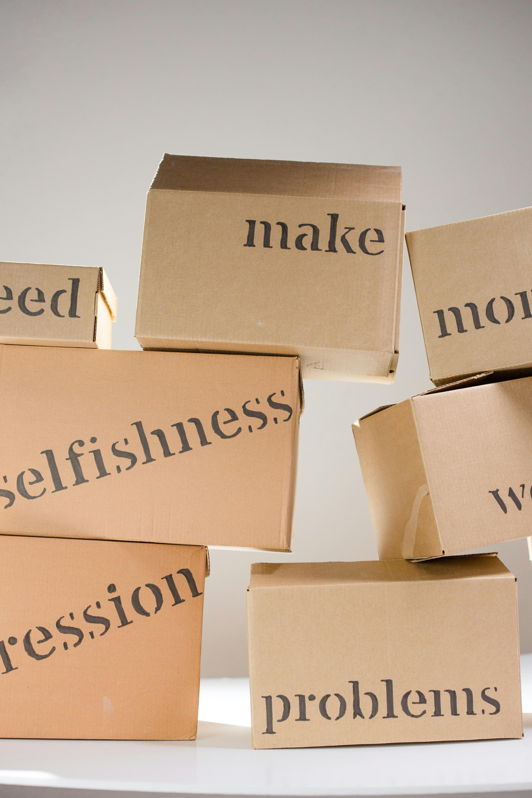
Asyncio Library
Support for concurrent code.
Uses `async` and `await` keywords.
Enables non-blocking I/O operations.
Efficient handling of asynchronous tasks.
Crucial for high-performance network applications.

Slide 15
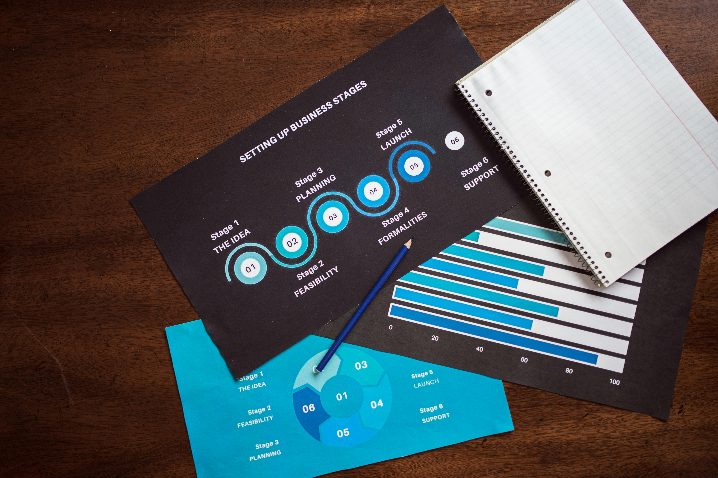
Python Applications
Web development (Django, Flask).
Data science (NumPy, Pandas).
Machine learning (TensorFlow, PyTorch).
Scripting and automation tasks.
Versatile and widely used.

Slide 16

Virtual Environments
Isolate project dependencies.
Use tools like `venv`.
Different projects, different library versions.
Prevents dependency conflicts.

Slide 17

Unit Testing
`unittest` and `pytest` frameworks.
Write and run unit tests.
Ensure code quality and maintainability.
Automated testing procedures.

Slide 18
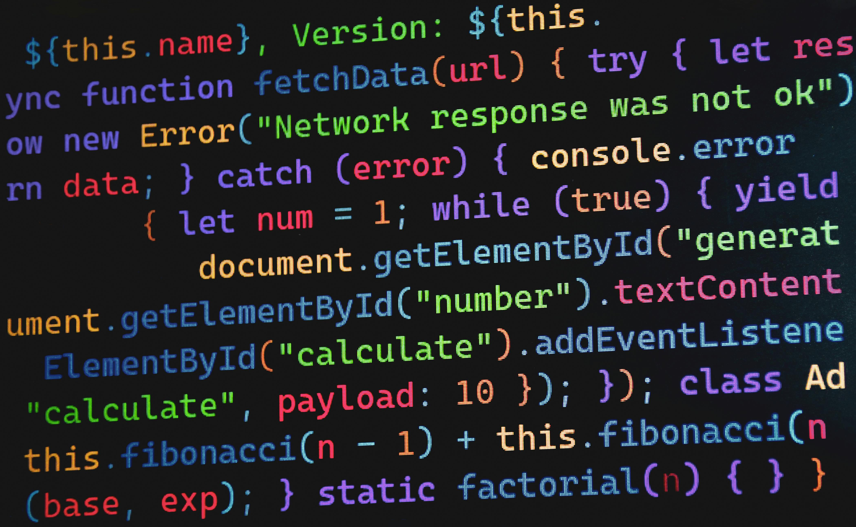
List Comprehensions
Concise way to create new lists.
Based on existing iterables.
Apply transformations to elements.
Filter elements in a single line.

Slide 19

Generators
Implemented using the `yield` keyword.
Memory-efficient iterators.
Produce values on demand.
Avoid storing large datasets in memory.
Useful for large files or infinite sequences.

Slide 20

Exception Handling
`try`, `except`, `else`, and `finally` blocks.
Gracefully handle errors.
Prevent program crashes.
Provide informative error messages.

Slide 21
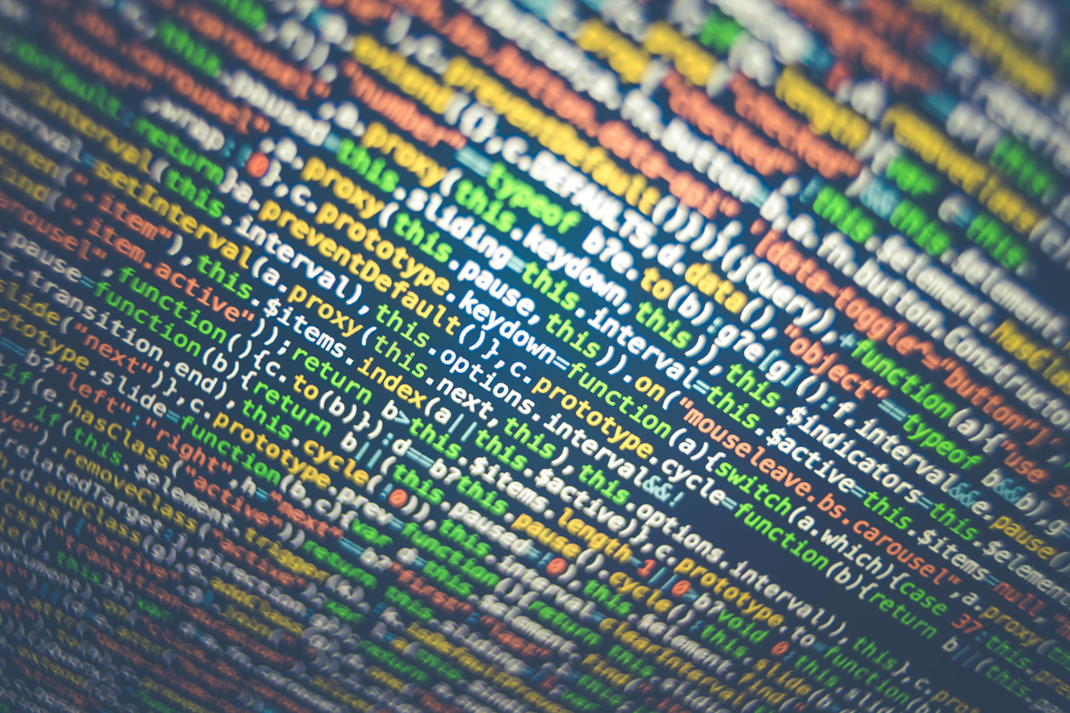
Logging Module
Record events and errors.
Valuable insights for debugging.
Useful for monitoring program execution.
Important for auditing purposes.

Slide 22
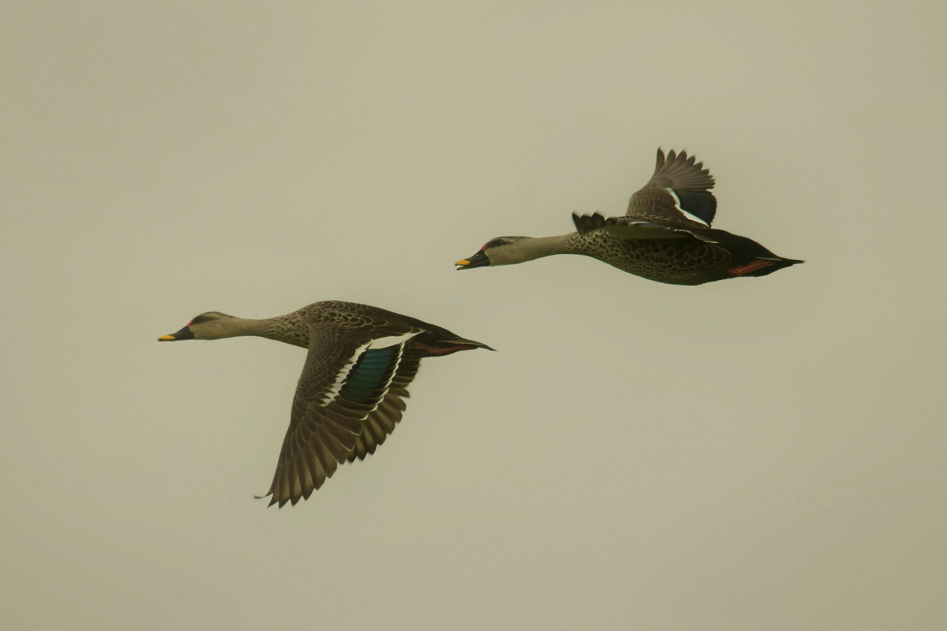
Pickling
Serialize Python objects to a byte stream.
Store objects in a file or transmit over network.
Enables object persistence.
Enables inter-process communication.
Security implications with untrusted sources.

Slide 23
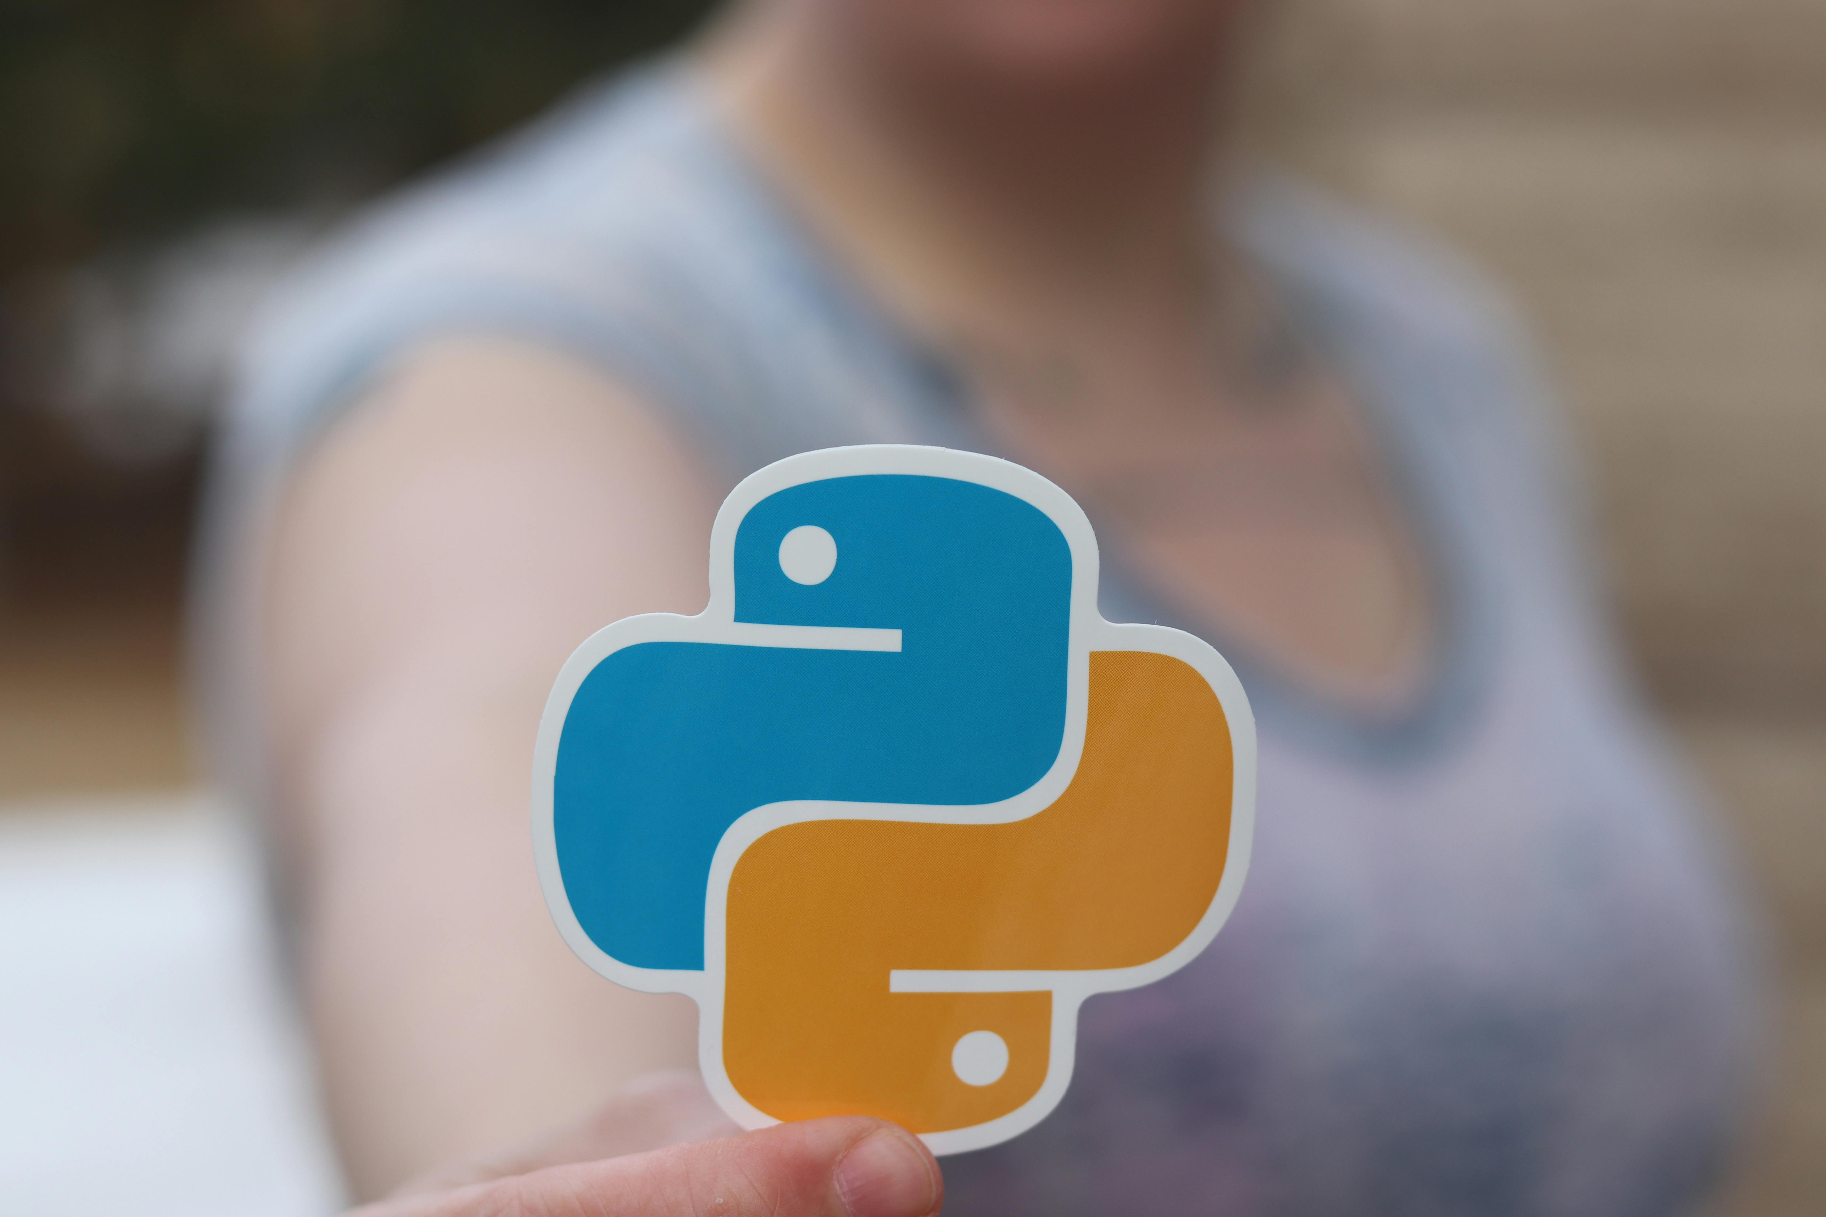
Monkey Patching
Modify/replace existing code at runtime.
Fix bugs or add features.
Adapt libraries without changing source.
Use cautiously due to maintainability.

Slide 24
Duck Typing
Type of object less important.
Focus on methods and attributes.
Flexible and dynamic code.
Works with different types having required interface.

Slide 25
Conclusion
Python empowers developers across domains.
Build sophisticated and scalable applications.
Continuously evolving with new features.
A leading programming language.

